Slide 1
Financial Aid: Money For College 101
NYC Regional Bilingual Education Resource Network at Fordham University
Francisco García-Quezada
Resource Specialist

Slide 2
Financial Aid: Money For College 101
Areas to be covered
Financing a college education and eligibility for financial aid:
What is Financial Aid?
Does my family qualify?
How much aid are we going to receive?
Timeline for the application.
Documents needed for the process.
Do I need loans?
How do we apply for loans or scholarships?
Regional Bilingual Education Resource Network (RBERN)

Slide 3
Financial Aid: Money For College 101
What is Financial Aid?
It’s money from the federal government, the state government, and the institution (college or university) that helps you pay for college, career school, or graduate school expenses.
Regional Bilingual Education Resource Network (RBERN)

Slide 4
Financial Aid: Money For College 101
Does my family qualify and How much aid are we going to get?
The “Formula”
Cost of Attendance
-minus
Expected Family Contribution (EFC)
= FINANCIAL NEED
Regional Bilingual Education Resource Network (RBERN)
Notes:
Does my family qualify and how much aid are we going to get?
Probably yes, and how much? Its determine by a formula - add up all the Cost of Attendance - minus Expected Family Contribution (EFC) - this is determine after you do the FAFSA application, and this equals = your Financial Need.

Slide 5
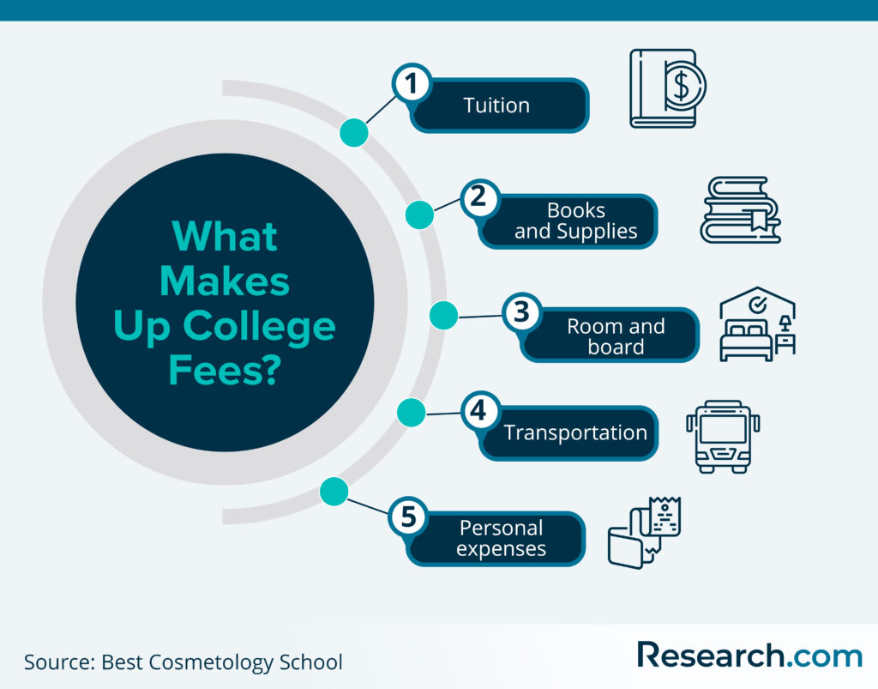
Financial Aid: Money For College 101
GETTING TO THE FINANCIAL NEED
Hard Costs- The “School Bill”
• Tuition and Fees
• Campus Room and Board
Soft Costs- The “Extras”
• Books and Supplies
• Transportation
• Living Expenses
• Miscellaneous
Regional Bilingual Education Resource Network (RBERN)
Notes:
The financial need is determined by adding the cost of everything related with the student attending an institution:
• Tuition and Fees - these are the cost by credits + fees
Fees included tech, library, etc.
• Campus Room and Board - these are the cost of living there the rental of a room with just enough furniture and your meals (plans are offered at different cost).
These are called hard costs - because these are the bulk of your expenses in college.
The soft or Extras should not be as much, unless your lifestyle is very extravagant. Books - can be bought (used or rented), Supplies - depends on what you are studying, Transportation - there is always public transport, or renting close to the school or living on campus, and your - Living Expenses & the Miscellaneous - need to fit your new life as a student; you are not on a long-extended vacation, sacrifices must be made. Budgeting and

Slide 6
Financial Aid: Money For College 101
What is meant by “Expected Family Contribution” Or The “EFC”?
Two Parts
• Student Contribution
• Parent Contribution
Factors Considered
• Income
• Assets- Savings, Investments (NOT RETIREMENT)
– Business Value – 529 College Savings Plans
• Number In Family
• Number In College
Constant – Doesn’t Change between schools
Regional Bilingual Education Resource Network (RBERN)
Notes:
After all the expenses are looked at and tally up -
You reduce the Expected Family Contribution that are determined by adding up all of these parts and you end up with what you will need to pay for college.
Notice that I stated - WHAT YOU WILL NEED - not What you will get.

Slide 7
Financial Aid: Money For College 101
What to Consider to Determine the Cost of Attendance
Identify priorities and college characteristics:
Academic programs / Interests
Types of colleges
Public
Private (Non-For-Profit)
Private (For Profit)
Size of student body
Location: City / Suburb / Rural
Campus life
On-Campus
Off-Campus / or At Home
Regional Bilingual Education Resource Network (RBERN)
Notes:
Types of Colleges:
Public Colleges and Universities are subsidized by Counties, City, State, and Federal Money.
The most popular in NYS are Community Colleges which are part of both CUNY and SUNY, The CUNY Schools - they are part of City University Of NY System.
and the SUNY Schools - they are part of the State University System.
Other States in the US - have them as well - but if you are not a resident of that County, City or State - you could be paying a higher or even doubled tuition to attend.
Private (non-for profit) - They are more expensive than the public schools - some are run by religious orders, but are not necessarily indoctrinating (there are more about their mission, and not about a profit.
They are generous in financial aid and will give institutional scholarships in merit, talent, skills, etc. In NY - we have many including the very well known: Columbia, Fordham, NYU, St. John’s, Cornell, etc.
Private (For Profit) - their mission is to serve the need in a particular niche - they are profit driven, and often have accelerated programs, but you need to be careful and do your research, some have come under a lot of scrutiny for their poor instruction, and falling short on their promises. Some have been sued, and had to close due to their reputation of not delivering.

Slide 8
Financial Aid: Money For College 101
How the type of college selected affects the bottom line:
Community Colleges
Four Year Colleges
Universities
Armed Forces
Technical Schools
Regional Bilingual Education Resource Network (RBERN)
Notes:
THE COLLEGE CHOICE PROCESS
LEARN ABOUT EACH COLLEGE that your child in interested in- help your child prioritize
CONSIDER AND REVIEW PRIVATE COLLEGES (NOT FOR PROFIT). The conversation should be about:
Does your child want to attend a small, medium or large college? Size CAN affect your child’s opportunities and experiences.
Is your child comfortable with big settings? What is the community around and near the college?
Does your child want to stay home while they attend college, or do they want to go away for college?
Does the college offer the academic programs and degrees that match your child’s college and career goals?
Do their colleges of interest offer extracurricular activities, athletics, clubs, and organizations are available?
Ask and discuss with your child if they would be interested in continuing to participate?
Let’s look at the Types of Colleges that are available.

Slide 9
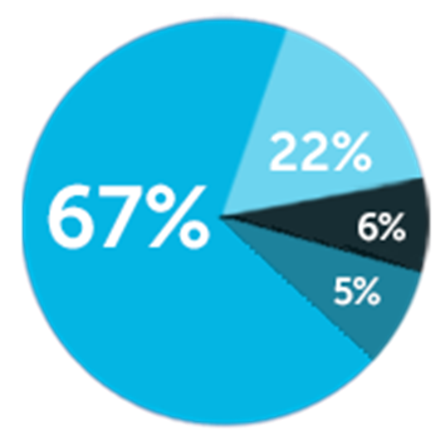
Financial Aid: Money For College 101
How To Pay For College: Money waiting for you...
Over $150 billion in financial aid is available to undergraduates for the 2022-2023 school year.
FINANCIAL AID COMES FROM MANY SOURCES:
67% Federal government grants, loans & other aid
22% College grants/ scholarships
6% Private and employer grants/scholarships
5% State government grants/scholarships
*Both PELL and TAP awards will be going up this term.
Source: FAFSA Student Aid Report
Regional Bilingual Education Resource Network (RBERN)
Notes:
PLEASE do not assume that you cannot afford to send your child to college because you think you don’t make enough money – This is a big mistake
While it is true that There is a big gap in the ways that resources and info are shared with ELLS parents – we are here to share information that you may not have received.
Lack of information contributes to the decision of whether our students to go or not to college.
WE want to help increase your opportunities to help your child go to college
Early planning is also very important to help increase the chance that ELLs have to apply to college, attend college and graduate from college to improve their economic status
IF WE LOOK AT THE CHART …. WE SEE THAT THERE ARE FINANCIAL RESOURCES AVAILABLE AND YOU NEED TO KNOW. LOOK AT CHART
FINANCIAL AID COMES FROM MANY SOURCES:
•67% = Federal government grants, loans & other aid
•22% = College grants/ scholarships
•6% = Private and employer grants/scholarships
•5% = State government grants/scholarships
In 2017-2018
•84% of first-time, full-time undergraduate students were awarded financial aid to attend 4-year degree colleges
•And 76% were awarded financial aid to attend 2-year degree colleges
During the 2020-2021 academic year, only 68% of students and their families submitted the FAFSA, down from 77% during the 2018-2019 academic year and 71% during the 2019-2020 academic year. 2020 - 2021 FAFSA Report.
Now we will review what you will need to apply for FAFSA.

Slide 10
Financial Aid: Money For College 101
COLLEGE SELECTION
Should Be Based On Programs & Degrees That Match Your Interests
Consider and Select Financial Aid Offers in this order:
Financial aid that does not have to be repaid
Scholarships and Grants
College of choice financial aid
Work-Study Program
Student or Parent Loans (SHOULD BE LAST OPTION)
Regional Bilingual Education Resource Network (RBERN)
Notes:
Financial Aid - SCHOLARSHIPS - WORK STUDY - INSTITUTIONAL SCHOLARSHIPS
DO NOT NEED TO BE PAY BACK
Grants made have a commitment of time / service, but does not need to be pay back if the commitment is fulfilled.
STUDENT AND OR PARENT LOANS NEED TO BE REPAY - right now there is a debt relief, but that is not a future guaranteed.
Federally supported loans or Subsidized Loans are better in interest rates than private banks or unsubsidized loans.
Personal advice - if you must take a loan, only if you must - have the student take the loan, not the parent.
Parents - if you can - work out a payment program, if you can not, talk to your accountants on what is best for your financial situation.
Again, if you must take a loan - and can only be a private loan - look into your credit union if you belong to one.

Slide 11
Financial Aid: Money For College 101
DOCUMENTS NEEDED
GATHER THESE DOCUMENTS BEFORE YOU START
•Social Security card/s
•Alien number or green if you are not a Citizen
•Driver’s license / NYS ID Card/s
•Student and parents’ 2020, 2021 or 2022 tax returns
•Student and parents’ 2020, 2021 or 2022 W-2 forms
•Untaxed income records
•Parents’ current bank statements
Student Aid Information: Home Page
Regional Bilingual Education Resource Network (RBERN)

Slide 12
Financial Aid: Money For College 101
Let’s Get Started
How to Fill Out the FAFSA Form Video
Regional Bilingual Education Resource Network (RBERN)

Slide 13
Financial Aid: Money For College 101
The FAFSA Application STEP BY STEP
Creating a FSA ID
Create an FSA ID or a Federal Student Aid Identification:
Have your SS #
Have a Computer or Mobile Phone (Download the APP)
A personal email address
How are you filing - as a dependent or independent student
This is determined by whether or not you as a student were claimed in your parents’ income tax papers when they filed.
Keep FSA ID information to one person (No sharing of SS # or emails).
Do not use your school email address - if you do not have one - create an individual personal email for you and a separate one for your parent or parents.
FOLLOW EVERY STEP TO VERIFY / CONFIRM EVERY TIME THAT YOU LOG ON.
Regional Bilingual Education Resource Network (RBERN)
Notes:
What You Can Use Your Account For
Filling out the Free Application for Federal Student Aid (FAFSA®) form
Signing your Master Promissory Note (MPN)
Refiling applications every year
Applying for repayment plans
Completing loan counseling
Using the Public Service Loan Forgiveness Help Tool
It is important to be truthful - specially when the documentation shows that you are who you are and that parents have claim you.
Keep FSA ID information to one person (No sharing of SS # or emails).
Do not use your school email address - if you do not have one - create an individual personal email for you and a separate one for your parent or parents.
Write these information as you do it - remember that you will need this information every time that you log on. AVOID - having to reset because you forgot your ID or your Parents. DO NOT SHARE THIS INFORMATION - IT CAN COMPROMISE A LOT OF PERSONAL INFORMATION.

Slide 14
Financial Aid: Money For College 101
Scholarships - How do I get them?
Four TYPES OF SCHOLARSHIPS:
Need-based scholarships
Merit-based scholarships: Academic, Artistic, and Athletic, etc.
Demographic-based scholarships for students who meet specific criteria
Work-Study
Regional Bilingual Education Resource Network (RBERN)
Notes:
Move to scholarship slide
There are 4 types of scholarships available:
Need-based scholarships
Merit-based scholarships - Academic, Artistic, and Athletic, etc.
Demographic-based scholarships for students who meet specific criteria
Work-Study
Scholarships are awarded to students based on academic or other achievements to help pay for education expenses.
A scholarship may:
Cover the entire cost of your child’s tuition, it may be a one-time gift or it may be renewable, depending on the scholarship.
Scholarships are gifts that don’t have to be repaid.
Tuition is the main expense of the college bill. It is the fee associated with taking each course, and it is often calculated per credit/point
A Need-Based scholarship is a financial award given to students based on the financial situation of the applicant and their families. Many need-based scholarships also consider an applicant’s grades and test scores
A Merit-based scholarship are based on: academic performance, demonstrated aptitude - on academic success in high school, talents and skills, such as in Athletics, Music, Art, Drama and performance based , such as - internships, a student’s leadership role, SAT and/or ACT scores, extracurricular activities and school or community activities
Demographic-based scholarships for students who meet specific criteria
there are scholarships for women, based on where your parents work, cultural or ethnic background, military families, heritage, gender, first-generation college students, union scholarships, etc. There also designated scholarships for other groups of people.
Federal Work-Study provides part-time jobs for undergraduate and graduate students with financial need, to earn money to help pay education expenses. The program encourages community service work and work related to the student’s course of study
There is no Federal law that prevents U.S. colleges from admitting undocumented students. Some colleges offer financial aid or scholarships to undocumented students. Private colleges often have special funds available.
Later in the presentation we will address how the DREAM ACT provides undocumented students with opportunities to attend college and receive financial assistance
We would like to highlight some specific programs available at City University of New York (CUNY) colleges that provide academic and financial support for students throughout their years in college

Slide 15
Financial Aid: Money For College 101
Are there any New York State Aid?
The New York State Tuition Assistance Program
NYS Excelsior Scholarship Program
The Excelsior Scholarship, in combination with other student financial aid programs, allows students to attend a SUNY or CUNY college tuition-free.
The program covers tuition for eligible SUNY and CUNY students.
For the 2022-23 academic year, families who earned $125,000 or less in the tax year 2019 or 2020 are eligible to apply.
FAFSA APPLICATION MUST BE COMPLETED FIRST
Regional Bilingual Education Resource Network (RBERN)

Slide 16
Financial Aid: Money For College 101
What if I am Undocumented, is there any Aid?
The NYS DREAM ACT opens the doors of financial aid to undocumented students for college. It also provides access to the Excelsior Scholarship, the Tuition Assistance Program (TAP) and other New York State‐administered scholarships.
Some of the New York State‐administered grants and scholarships support their college costs.
To apply to the NYS Dream Act, please visit:
www.hesc.ny.gov/dream/
Regional Bilingual Education Resource Network (RBERN)
Notes:
There is also a misconception about opportunities for undocumented students to attend college. While their opportunities are limited in some states, this is not the case in New York State.
Eligibility
Permanent lawful resident
Paroled refugee
U-Visa
T-Visa
Temporary Protected Status (TPS)
Without lawful immigration status (Undocumented)
Undocumented students do not follow the financial aid process through FAFSA. Undocumented students eligible under the provision of the DREAM ACT:
Must first apply for eligibility under the NYS Dream Act before applying for TAP.
Students in this category are not eligible to complete the FAFSA. However, they can complete the NYS Tuition Assistance Form at HESC.
The Dream Act provides access to other scholarships and grants, such as the TAP, and Excelsior and other NYS-administered scholarships
If you have previously qualified under the NYS Dream Act, you will simply need to add a new application to apply for TAP
Please note, that undocumented and US citizens are eligible for the DREAM Act.
Let’s see how you can decide what the best college choice would be for your child.

Slide 17
Financial Aid: Money For College 101
RESOURCES:
The College Board: www.collegeboard.org
CSS Profile: https://cssprofile.collegeboard.org/
TAP Application: https://www.hesc.ny.gov/pay-for-college/apply-for-financial-aid/nys-tap/apply-for-tap.html
FAFSA ID: https://studentaid.gov/fsa-id/create-account/launch
FAFSA Application: https://fafsa.ed.gov/spa/fafsa/#/LOGIN?locale=en_US
TAP award estimator: TAP Award Estimator.
NYS Grant/Scholarship: NYS Excelsior Scholarship Program
Regional Bilingual Education Resource Network (RBERN)

Slide 18
Financial Aid: Money For College 101
What is meant by “Expected Family Co
NYS Excelsior Scholarship Program
Scholarship Directory for Non-Citizen and Undocumented Students - Google Sheets
NYS Language Regional Bilingual Education Resource Network (RBERN) at NYU
NYC/NYS Regional Bilingual Education Resource Network at Fordham University
Bill of Rights for Parents of ELLS / MLLS
New York State ELL Parent Hotline - 1-(800) 469-8224
Regional Bilingual Education Resource Network (RBERN)

Slide 19
Financial Aid: Money For College 101
Regional Bilingual Education Resource Network (RBERN)

Slide 20
Financial Aid: Money For College 101
For more information or to set-up a more detail presentation - contact me at:
Francisco A. García-Quezada
Resource Specialist
1-718-817-0606 Ext. 1475
or
fgarciaquezada@fordham.edu
NYC RBERN WEBSITE
Regional Bilingual Education Resource Network (RBERN)

